Slide 1

Wafer Manufacturing
By Maximilian See | 2102869A

Slide 2


Introduction
1
Intel ARC
Wafer manufacturing is the process of creating silicon wafers that are used as the base for integrated circuits (ICs) and other microelectronic devices. The manufacturing process involves a series of steps, including crystal growth, slicing, polishing, and doping, among others. The wafer manufacturing industry is dominated by a few major players, including Intel, Samsung, TSMC, and GlobalFoundries. These companies specialize in producing high-quality wafers for a wide range of applications, including smartphones, computers, and other electronic devices. Additionally, there are also many smaller players in the industry that provide niche products and services to the semiconductor industry.
ARC

Slide 3
Why Semi Conductor ?
1
Intel ARC
Major semiconductor companies like Intel, Samsung, TSMC, and GlobalFoundries supply wafers that are crucial for manufacturing microchips and electronic components in various consumer products. Wafer quality affects production costs, and defects or inconsistencies can lead to manufacturing issues, lower yields, and increased costs, which may result in higher prices for consumers. Conversely, lower wafer production costs may enable semiconductor companies to offer competitive pricing and lower prices for consumers. Therefore, the cost of wafer production can have a significant impact on the final price of consumer products in the industry.
ARC

Slide 4
Model Road Map
Part 1 : CNN
Notebook: 1
Status: Discontinued
The start of the project focused on converting the wafer dimension to Images. Due to the mass number of images the training process was often intensive in terms of time and resources. Better alternatives were sought after in the second part of the project
Part 2: 2nd level Extracted Features & CNN
Notebook: 2
Status: Discontinued
The start of the 2nd project focused on a particular wafer dimension to save time and resources to speed up development and analysis. The key idea was to develop the model on extracted features from the wafer maps for more interpretability. While also reducing the resource intensive nature of using converting the wafer maps to full fledge images, training on them and making inference on them. However, the extracted features, which are low level features found in the frequency domain serve little to no improvement. Even though CNN is king in terms of accuracy, it lacks in inference speed and needs high computational requirements . The third part of the project focuses on higher level features like density and shape and also seeks to further inference speed.
Part 3: 1st level Extracted Features, Ensemble & AAE
Notebook: 3
Status: Operational
The start of the 3rd project focused on the wafer maps which have labels. Since we aim to reduce the training time and inference speed by using purely extracted features and smaller model sizes, we have up the wafer count. This brings us from a measly 17000 wafer maps to over 179000 wafer maps. The model which was chosen for this process is the Adversarial auto encoder. The model showed considerable performance when compared to SVM, when carefully tuning the threshold value.
Part 3 also features ensemble methods. The slides below focus on the 3rd Part of the project.

Slide 5
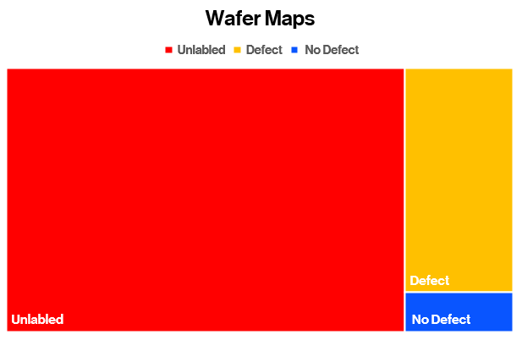
Dataset Preprocessing
The WM811K Wafer Map dataset, which can be accessed on Kaggle, comprises of images that display the wafer maps captured during the production of semiconductor devices. The dataset was curated by Qingyi. In total, the dataset contains 811,457 entries, where each entry corresponds to a wafer map of a semiconductor device. These entries are represented as 2D arrays with variable dimensions and are labeled with a class indicating the wafer map class. (We later converted the normal class to 0 and the abnormal class to 1) The dataset also contains a CSV file that provides metadata for each 2D Wafer Map, such as details about the production line, wafer ID, and lot ID.

Slide 6
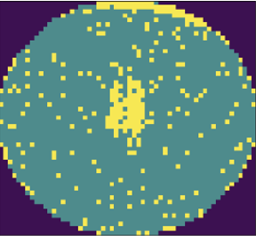


Dataset Preprocessing
The difference between each class are significant. Base on observation we can discern that Center means that the wafers are defective mainly in the Center. When there is a scratch, it is a long line that stretches from one end to the other and for Edge-Ring it usually means that the edges of the wafer are defective. With this knowledge we can employ feature extraction which could utilise these additional high-level information. These wafers however contain noise & might affect the accuracy of the model. Additionally, the imbalance in dataset might cause generalization issues for the model we are creating later.
Center
Scratch
Edge- Ring

Slide 7

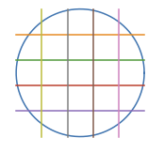


fastNlMeansDenoising
Feature Extraction
Ensemble Methods
The fastNlMeansDenoising() function is a computationally efficient implementation of the Non-local Means Denoising algorithm. It takes an input image and reduces noise by comparing similar patches of pixels in the image. By averaging the pixel values of these similar patches, it estimates the clean pixel value for each location in the image. Done so as not to confuse the model with noise and for feature extraction.
The model is trained upon the features which we extract from the images, this reduces the high dimensionality and computational requirements of CNN and promotes faster inference in real time. The features extracted are density-based features, Geometric based features and Radon. In total we have 59 inputs to work with rather than 676 inputs (26x26) if we decide to use a CNN based model. Interpolation is done to make up for the uneven wafer map dimensions
Ensemble Method refers to a machine learning approach that enhances predictive accuracy and mitigates overfitting by combining multiple models, such as decision trees or neural networks

Slide 8
Model Building
Extracted Features
Adversarial Autoencoders (AAEs) are deep learning models used for unsupervised anomaly detection. AAEs combine an autoencoder with a discriminator, trained adversarially. The autoencoder compresses data into a latent space and reconstructs it, while the discriminator differentiates between normal and anomalous latent representations. During training, the autoencoder minimizes reconstruction error, while the discriminator aims to classify encoded data correctly. AAEs detect anomalies based on higher reconstruction error. They capture complex patterns, learn robust representations, and have applications in fraud detection, network intrusion detection, and medical anomaly detection.
The key idea behind AAEs for our case is to encourage the encoder to generate representations that are indistinguishable from the prior distributions, thus forcing it to learn a meaningful and disentangled latent space. By doing so, AAEs can capture the underlying structure and variations in the data, enabling tasks like anomaly detection.
Adversarial Auto Encoder
Outcome

Slide 9
Experimental Models
Images
Extracted Features
Images
Extracted Features
2D CNN
AE
PPO
GANs
MLP
Decision Tree Classifier
Outcome
Outcome
Outcome
Notes:
As an experiment, we also tried more methods. These methods increase the training time and inference speed. However, these models show a higher accuracy than our previous models. Perhaps, when better hardware is available, such large models could be used.
The model includes a EfficientNetB2 & a larger Auto Encoder Network along with a MLP. To ensure a no compromise approach we also included a Decision Tree Classifier at the end of the network.
The second experiment involves using OpenAI PPO or Re-Enforcement Learning for classification.

Slide 10
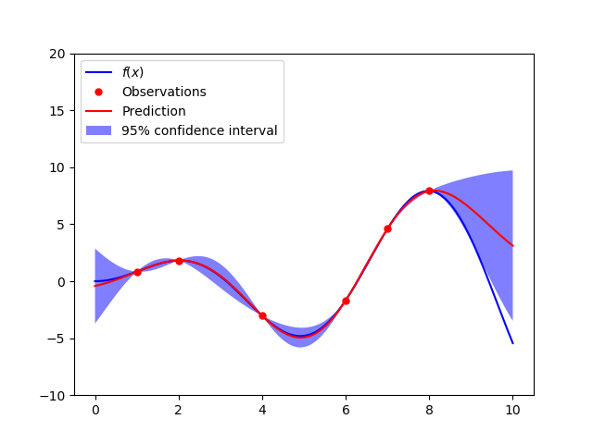
Bayesian Optimization
Model Fine-Tuning
For the model fine tuning we would be using the Gaussian Bayes Naïve Algorithm to fine the best hyper parameters.
Bayesian optimization is a method for finding the best set of parameters for a machine learning model. It works by creating a probability model of how the model's performance is affected by changes in its parameters

Slide 11
Experimental Models Evaluation & Analysis
Experimental models like PPO for image classification (Image data !) prove to be effective, at 90 – 94% accuracy it serves as a testament that Re enforcement learning could be used as an image classification model.
However, looking at the wider picture CNNs still perform superior to that of Re Enforcement Learning. At ~98% accuracy, F1 & Recall, as well as faster inference & training speed, CNNs crushes Re enforcement learning in Image classification
Experimental Model like the Hybrid Decision Tree Classifier & Neural Network prove to be more effective than conventional CNNs, boasting an accuracy of 99% accuracy across F1 & Recall scores, while also not affecting much of inference and training speeds.
However, the training time as compared to other Unsupervised learning models like the Adversarial Auto Encoder is much more and the equipment it takes to run these model might need to be stronger to run the CNN or PPO models. In addition, the real world does not always have labeled data for our supervised learning models . Thus, we adopt the unsupervised learning model to avoid high computational requirements, lower training time for out models and rely less on labeled data.

Slide 12

Model Evaluation & Analysis
When tuned the Adversarial Auto Encoder can perform as well as a standard Neural Network or CNN. The accuracy of the Adversarial Auto Encoder can come in at around 97% when tuned on the testing data or evaluation data.
While our Adversarial Auto Encoder is accurate, we also consider other methods like Decision Tree Classifier, Multilayer perceptron and Isolation Forest to further validate our results. More will be discussed in the Ensemble Modelling section

Slide 13
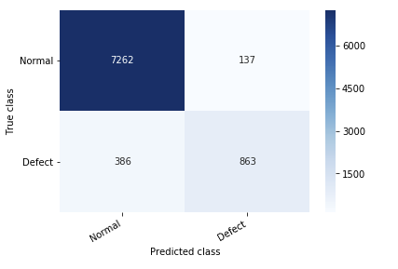
Ensemble Modeling
To further ensure that the model does not overfit on the current data, we have also employed ensemble modelling to reduce overfitting and more reliable results. The results from three models 2 of which are unsupervised learning algorithms : Isolation and Adversarial Auto Encoder while the other is a supervised learning Algorithm: XGB or Neural Network. The output of the models would then be placed in a data frame.
Once the data frame has been filled with the outputs of the predictions from the three models, we employ a simple Neural Network to deduce the true class of wafer Map. This method reduces our false positives and false negatives and hence increases our model overall accuracy and hence reliability.
Our final Accuracy for the model is 92%. With a loss of 0.24.

Slide 14
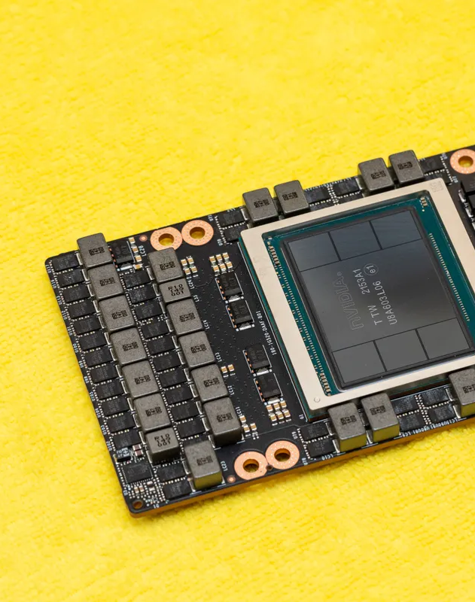
Conclusion
In conclusion, the quality of wafers used in semiconductor production has a significant impact on the final price of consumer products. With the continual rise of AI and its intense computational requirement chip production would be increased to meet the immense demands of todays and tomorrows AI workload.
Not only that, as chip manufacturing continues to advance into the Nano or Pico meters, the production process would also be increasingly complex. This warrants for increased reliability and quality control of chip manufacturing.
Our project has contributed to the space by ensuring high accuracy in detecting defects in chips and also reduced the need for machine vision technologies, keeping inference speed fast and production cost low.
Overall, this model can help semiconductor companies improve wafer quality, reduce production costs, and offer competitive pricing to consumers.

Slide 15
Reflection
Challenges:
What worked well:
What could have been done differently?
The model building and data pre-processing have been challenging, despite being an enjoyable experience. The dataset used for training the model had limited important features and suffered from class imbalance, which is crucial for supervised learning. Since CNN cannot be used for the wafer data, alternative methods were explored to achieve comparable accuracy. Extracting information from the images involved analyzing low-level features in the frequency and spatial domain using techniques like GLCM and HAAR wavelets. However, these attempts did not improve the model and instead slowed down the inference speed. Nevertheless, they provided insights for exploring more appropriate tactics in subsequent notebooks.
In the third notebook, the model and feature extraction techniques were revised. The main idea was to extract high-level features like those obtained by a CNN and use an Auto Adversarial Encoder to mimic CNN-like feature extraction from images. The extracted features included Density, Shape, and Radon, which were more advanced than GLCM or HAAR wavelets. With these changes, the model achieved 93% accuracy, outperforming the previous notebook that used SVM with 80% accuracy.
Taking a top-down approach and having a holistic view from the beginning instead of starting with a narrow perspective. In other words, focusing on the basics first before delving into complex details and potentially wasting time.
Find a way to reduce the false negatives.

Slide 16
Thank You

Slide 17
References
https://paperswithcode.com/paper/anomaly-detection-with-adversarial-dual
https://arxiv.org/pdf/1902.06924
https://openai.com/
https://www.kaggle.com/code/ashishpatel26/wm-811k-wafermap
https://www.kaggle.com/code/kcs93023/keras-wafer-classification-cnn2d-with-augmentation
https://xgboost.readthedocs.io/en/stable/parameter.html
https://scikit-
learn.org/stable/modules/generated/sklearn.ensemble.IsolationForest.html
https://www.analyticsvidhya.com/blog/2021/05/bayesian-optimization-bayes_opt-or-hyperopt/
https://towardsdatascience.com/automated-machine-learning-hyperparameter-tuning-in-python-dfda59b72f8a
Temsek Poly Slides

